Slide 1
Dependency Injection

Slide 2
Dependency Injection (DI)
Dependency Injection (DI) is a design pattern that removes the dependency from the programming code so that it can be easy to manage and test the application.
Dependency Injection makes our programming code loosely coupled.

Slide 3
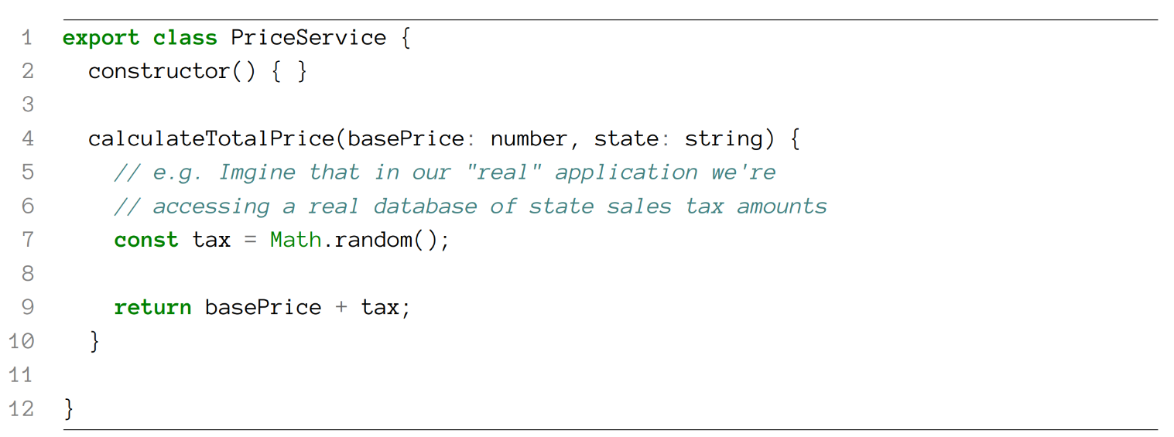
Injections Example
Let’s imagine we’re building a store that has Products and we need to calculate the final price of that product after sales tax.
Notes:
In order to calculate the full price for this product, we use a PriceService that takes as input

Slide 4
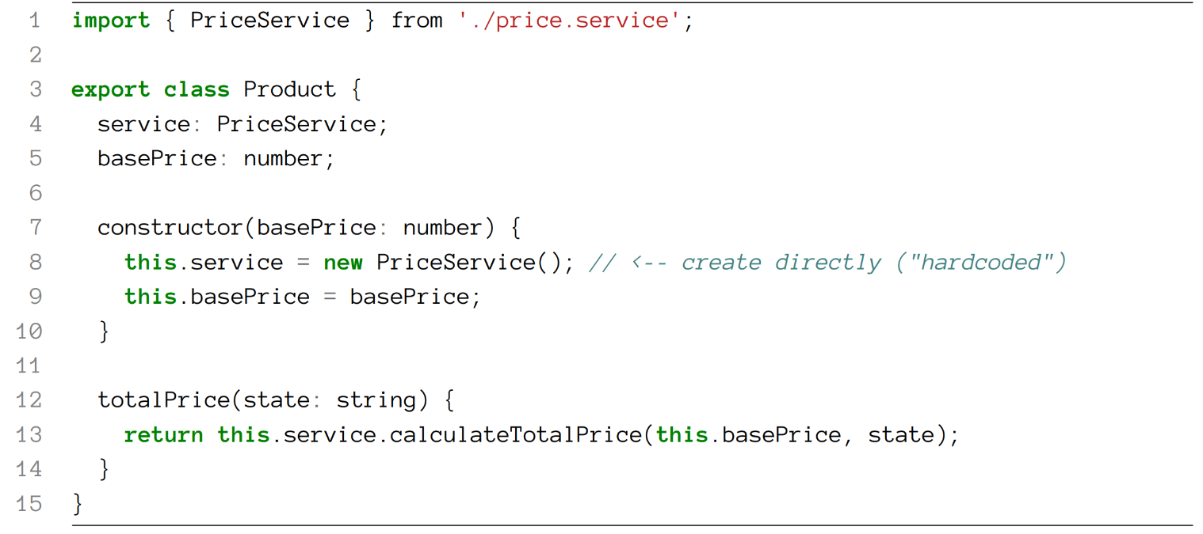
Injections Example
Say we want to use this service on our Product model. Here’s how it could look without dependency injection:

Slide 5
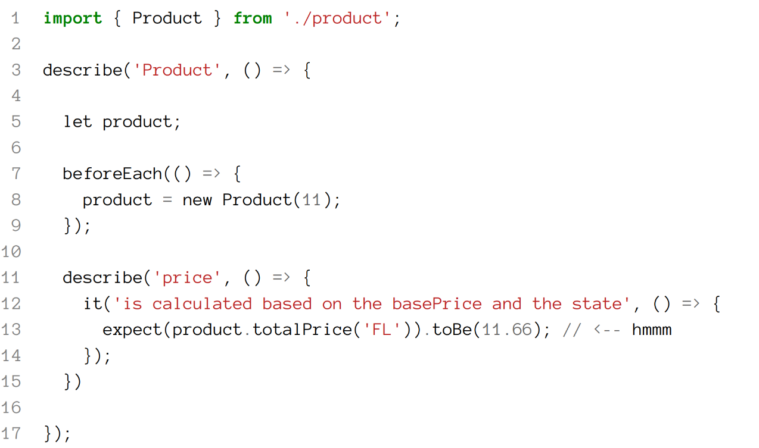
Injections Example - Test
Notes:
Now imagine we need to write a test for this Product class. We could write a test like this: The problem with this test is that we don’t actually know what the exact value for tax in Florida ('FL') is going to be. Even if we implemented the PriceService the ‘real’ way by calling an API or calling a database, we have the problem that: • The API needs to be available (or the database needs to be running) and • We need to know the exact Florida tax at the time we write the test.

Slide 6
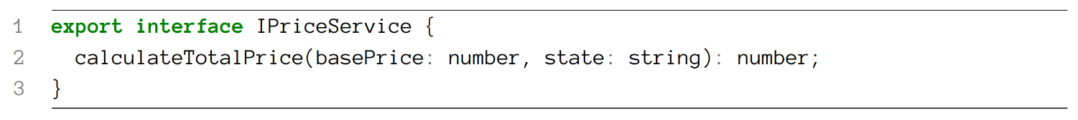
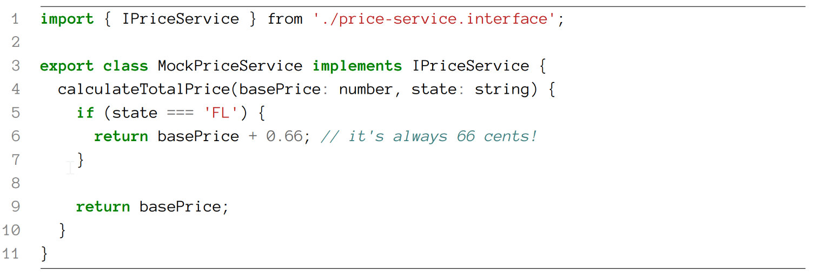
Injections Example - MockPriceService

Slide 7
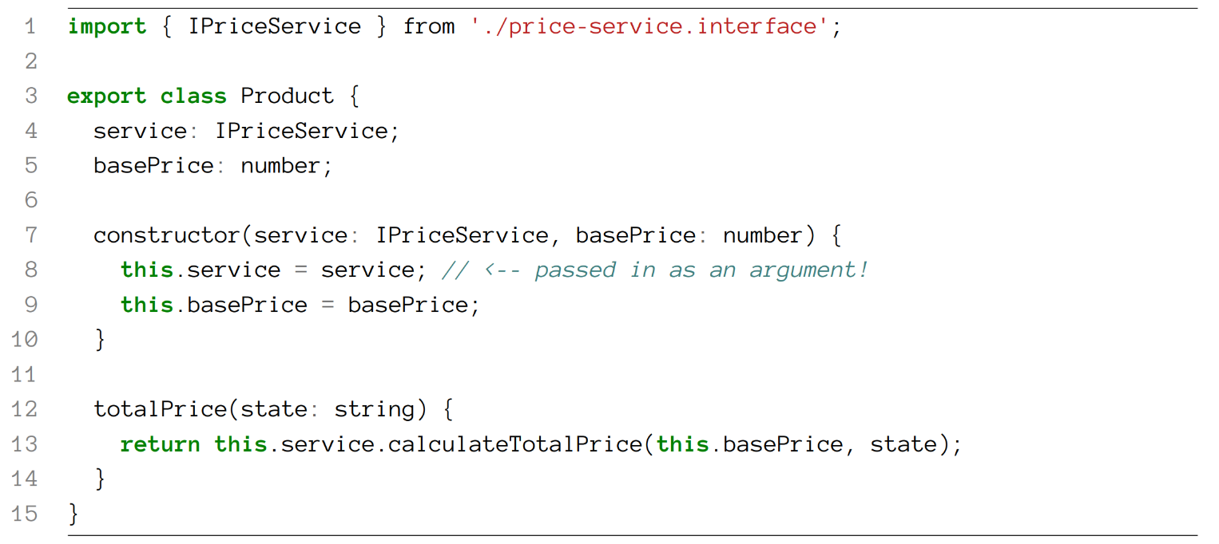
Injections Example - Product

Slide 8
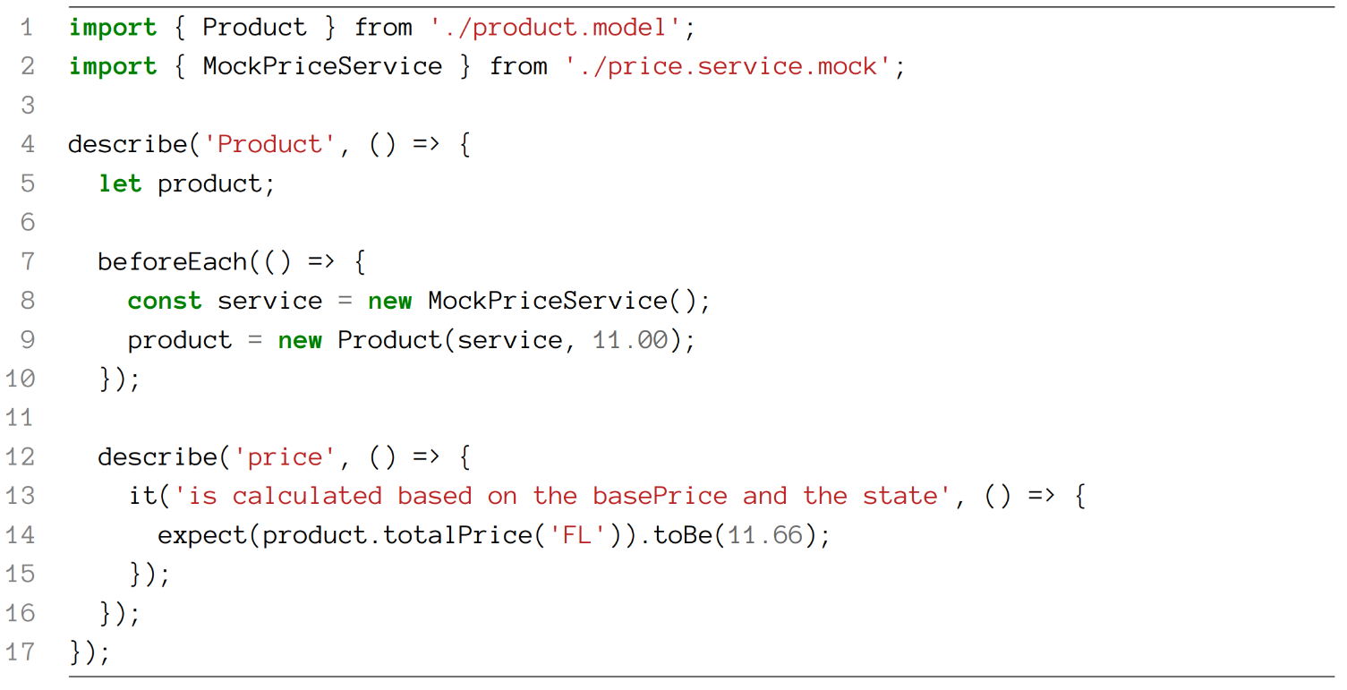
Injections Example - Test
Notes:
We also get the bonus of having confidence that we’re testing the Product class in isolation. That is, we’re making sure that our class works with a predictable dependency.

Slide 9
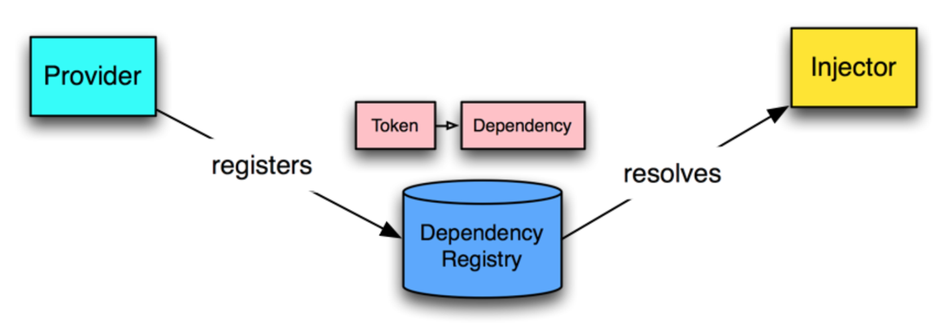
Dependency Injection Framework Architecture

